Slide 1
Employee Performance Analysis Using Excel
PRESENTED BY: Y.YUVARANI
REGISTER NO: 312204642
DEPARTMENT: COMMERCE
COLLEGE: K.C.S KASI NADAR COLLEGE OF ARTS AND SCIENCE

Slide 2
PROJECT TITLE
Employee Performance Analysis Using Excel

Slide 3
AGENDA
1.Problem Statement
2. Project Overview
3.End Users
4.Our Solution and Proposition
5. Dataset Description
6. Modelling Approach
7. Results and Discussion
8.Conclusion

Slide 4
PROBLEM STATEMENT
1. Imbalance lies uniformly Low Scores, yet With Subtle variations.
2. Identify key issues or challenges
3. Formulate a clear problem statement
4. Employee Development content
5. Employee Satisfaction and Retention Risk

Slide 5
PROJECT OVERVIEW
[Employee Performance Improvement and Pay Zone Optimization]
Employee Attrition Analysis Using Excel Dashboards
Creating an Employee Performance Scorecard in Excel
Using Pivot Tables for Employee Turnover Analysis
Visualizing Employee Attendance Trends with Excel Charts
Salary and Compensation Analysis Through Excel Data Modeling

Slide 6
WHO ARE THE END USERS?
Human resources HR Department
Managers and supervisors
Executives and leadership
Learning and Development
Talent Acquisition

Slide 7
OUR SOLUTION AND ITS VALUE PROPOSITION
The solution is designed to track, evaluate, and enhance employee performance across various dimensions like productivity, skills, behavior, and goal alignment.
Performance Metrics Dashboard: Comprehensive visual analytics on individual and team performance.
Data-Driven Decision Making: Empowers management with actionable insights for promotions, rewards, and talent development, improving accuracy and fairness.
Scalability & Flexibility: Adapts to various organizational sizes, supporting both small businesses and large enterprises with customizable features.
Predictive Analytics: Uses AI to forecast employee performance trends, helping businesses proactively address potential issues.

Slide 8
DATASET DESCRIPTION
EMPLOYEE ID: Unique identifier for each employee in the organization.
FIRST NAME: The first name of the employee.
PAY ZONE: The pay zone or salary band to which the employee's compensation falls.
DEPARTMENT TYPE: The broader category or type of department the employee's work is associated with.
CURRENT EMPLOYEE RATING: The current rating or evaluation of the employee's overall performance.

Slide 9
MODELLING
Data set: Kaggle, Employee dataset
Feature Selection:
Data Cleaning: Missing values, Irrelevant
Pivot Table: Employee ID, First Name, Payzone, DepartmentType, Current Employee Rating.
Performance:
Report: Slicer
Chart: Bar diagram

Slide 10
RESULTS

Slide 11
CONCLUSION
The analysis of employee performance ratings across departments reveals significant variability. Departments 3437, 3441, and 3445 demonstrate consistently high performance, indicating effective management practices or a higher skill level among employees. In contrast, departments 3443 and 3442 have lower ratings, suggesting potential areas for improvement. These insights can guide targeted interventions, such as focused training or process optimizations, to uplift the overall performance across departments. Regular monitoring and feedback mechanisms should be instituted to ensure sustained improvements.Let me know if this aligns with your project or if you need further adjustments!

Slide 12
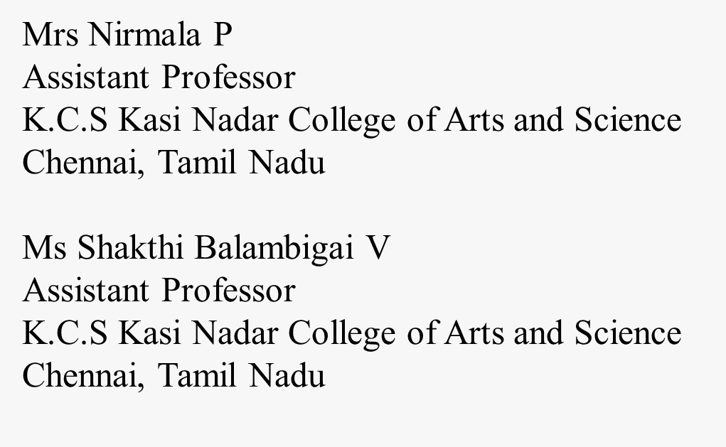
REFERENCE

